Slide 1

Notes:
[Sources]
- Korean source deck, slide 1.
- English text-localization applied to the approved complete-slide design.

Slide 2

Notes:
[Sources]
- Korean source deck, slide 2.
- English text-localization applied to the approved complete-slide design.

Slide 3
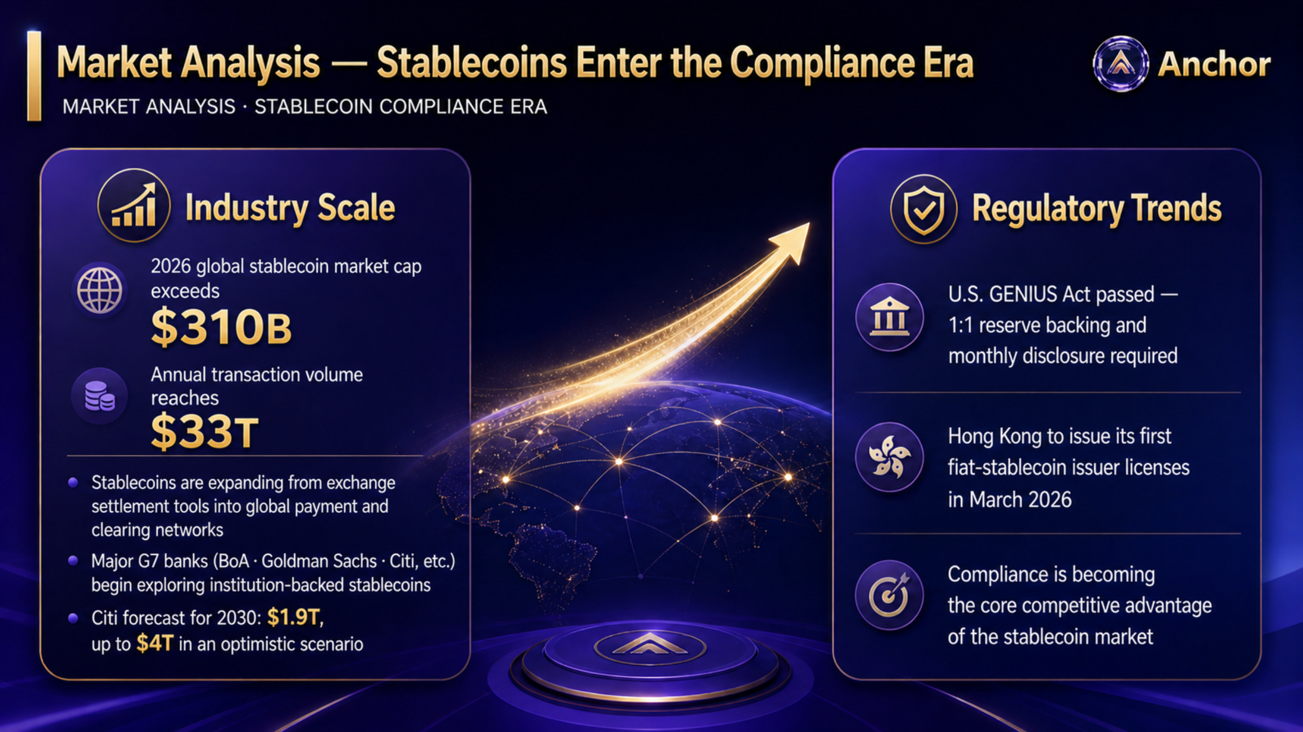
Notes:
[Sources]
- Korean source deck, slide 3.
- English text-localization applied to the approved complete-slide design.

Slide 4

Notes:
[Sources]
- Korean source deck, slide 4.
- English text-localization applied to the approved complete-slide design.

Slide 5
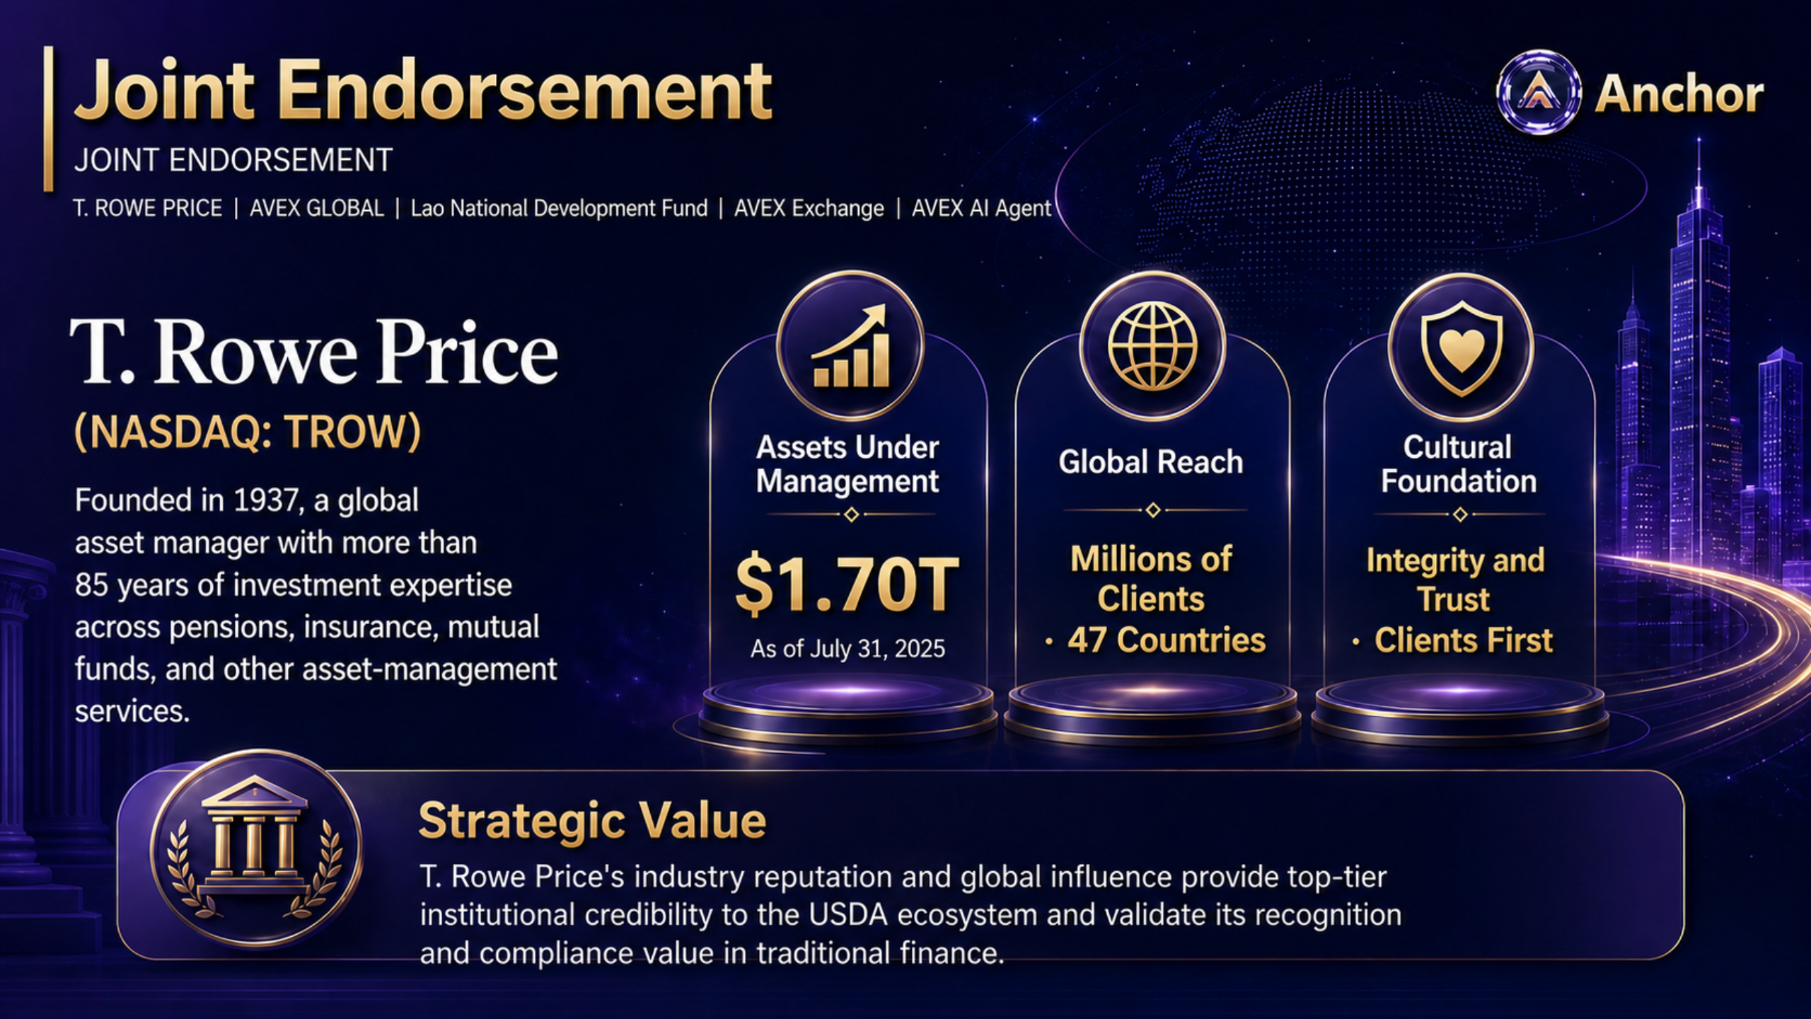
Notes:
[Sources]
- Korean source deck, slide 5.
- English text-localization applied to the approved complete-slide design.

Slide 6
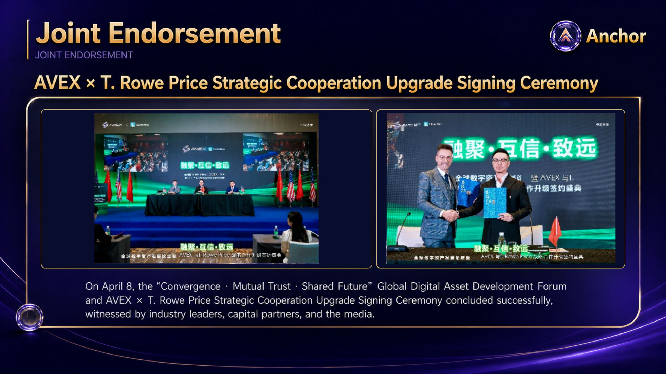
Notes:
[Sources]
- Korean source deck, slide 6.
- English text-localization applied to the approved complete-slide design.
- Authentic event photographs restored from the original source slide.

Slide 7
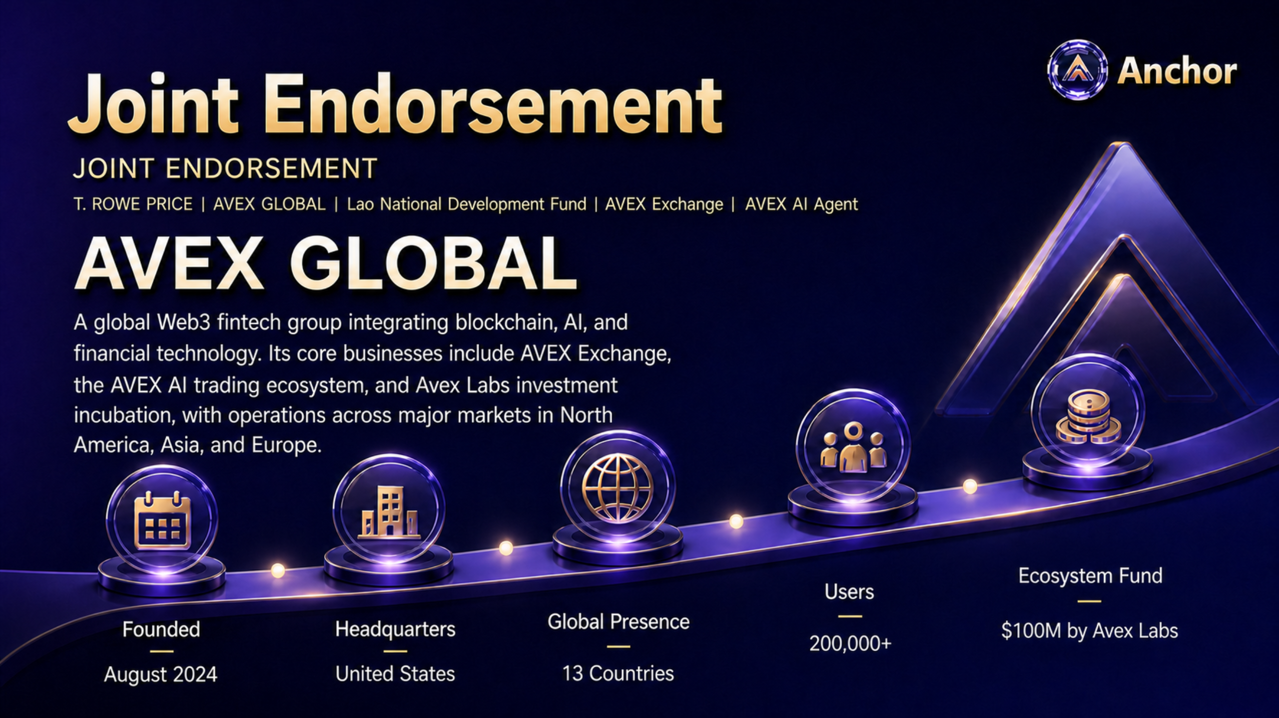
Notes:
[Sources]
- Korean source deck, slide 7.
- English text-localization applied to the approved complete-slide design.

Slide 8

Notes:
[Sources]
- Korean source deck, slide 8.
- English text-localization applied to the approved complete-slide design.

Slide 9
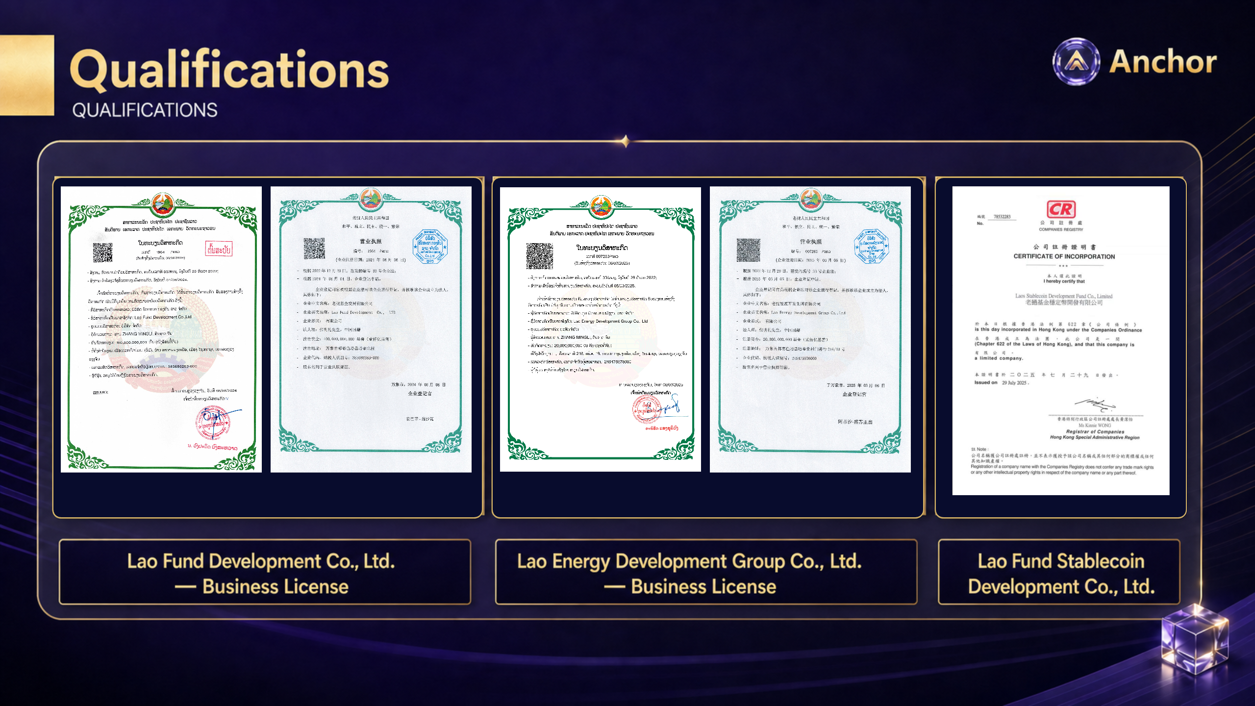
Notes:
[Sources]
- Korean source deck, slide 9.
- English text-localization applied to the approved complete-slide design.
- Authentic qualification, registration, and license images restored from the original source deck.

Slide 10
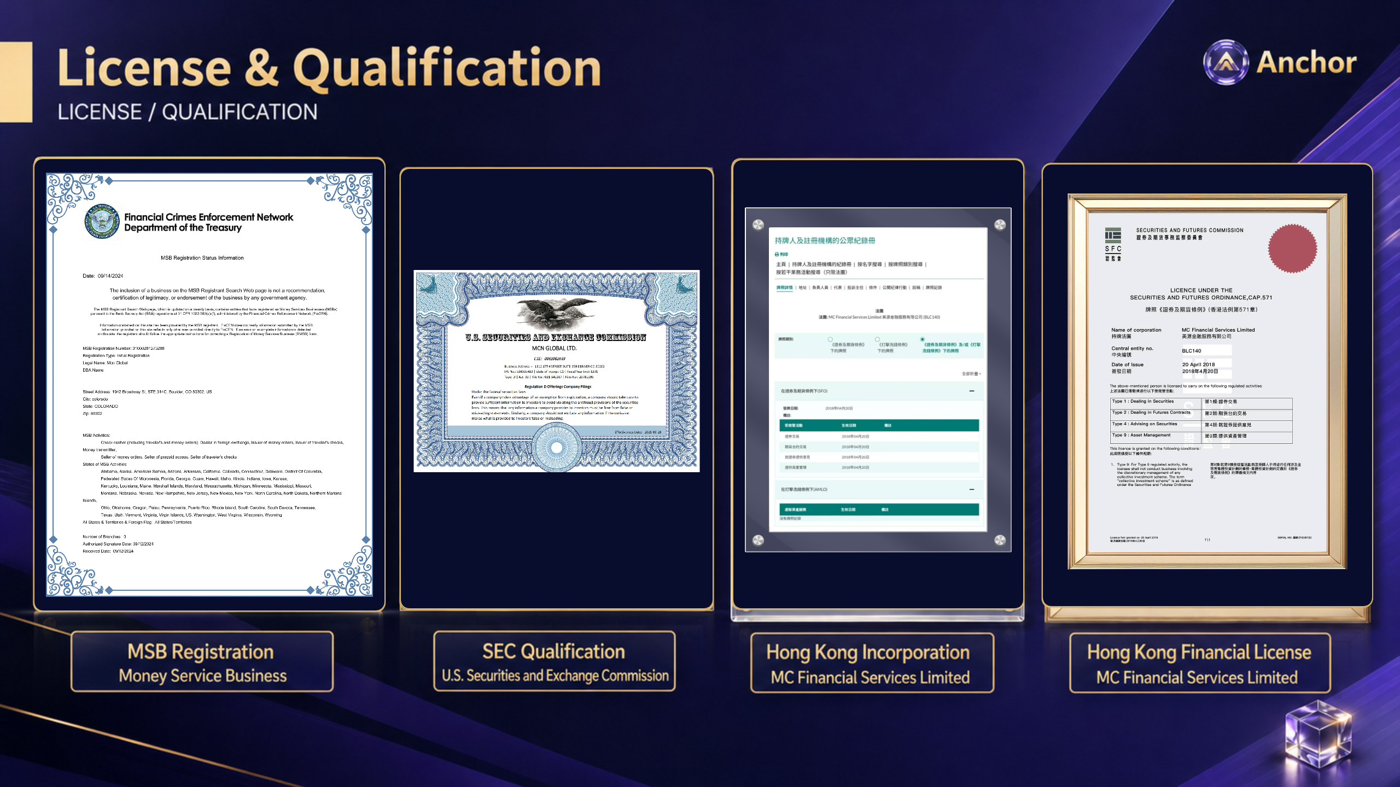
Notes:
[Sources]
- Korean source deck, slide 10.
- English text-localization applied to the approved complete-slide design.
- Authentic qualification, registration, and license images restored from the original source deck.

Slide 11
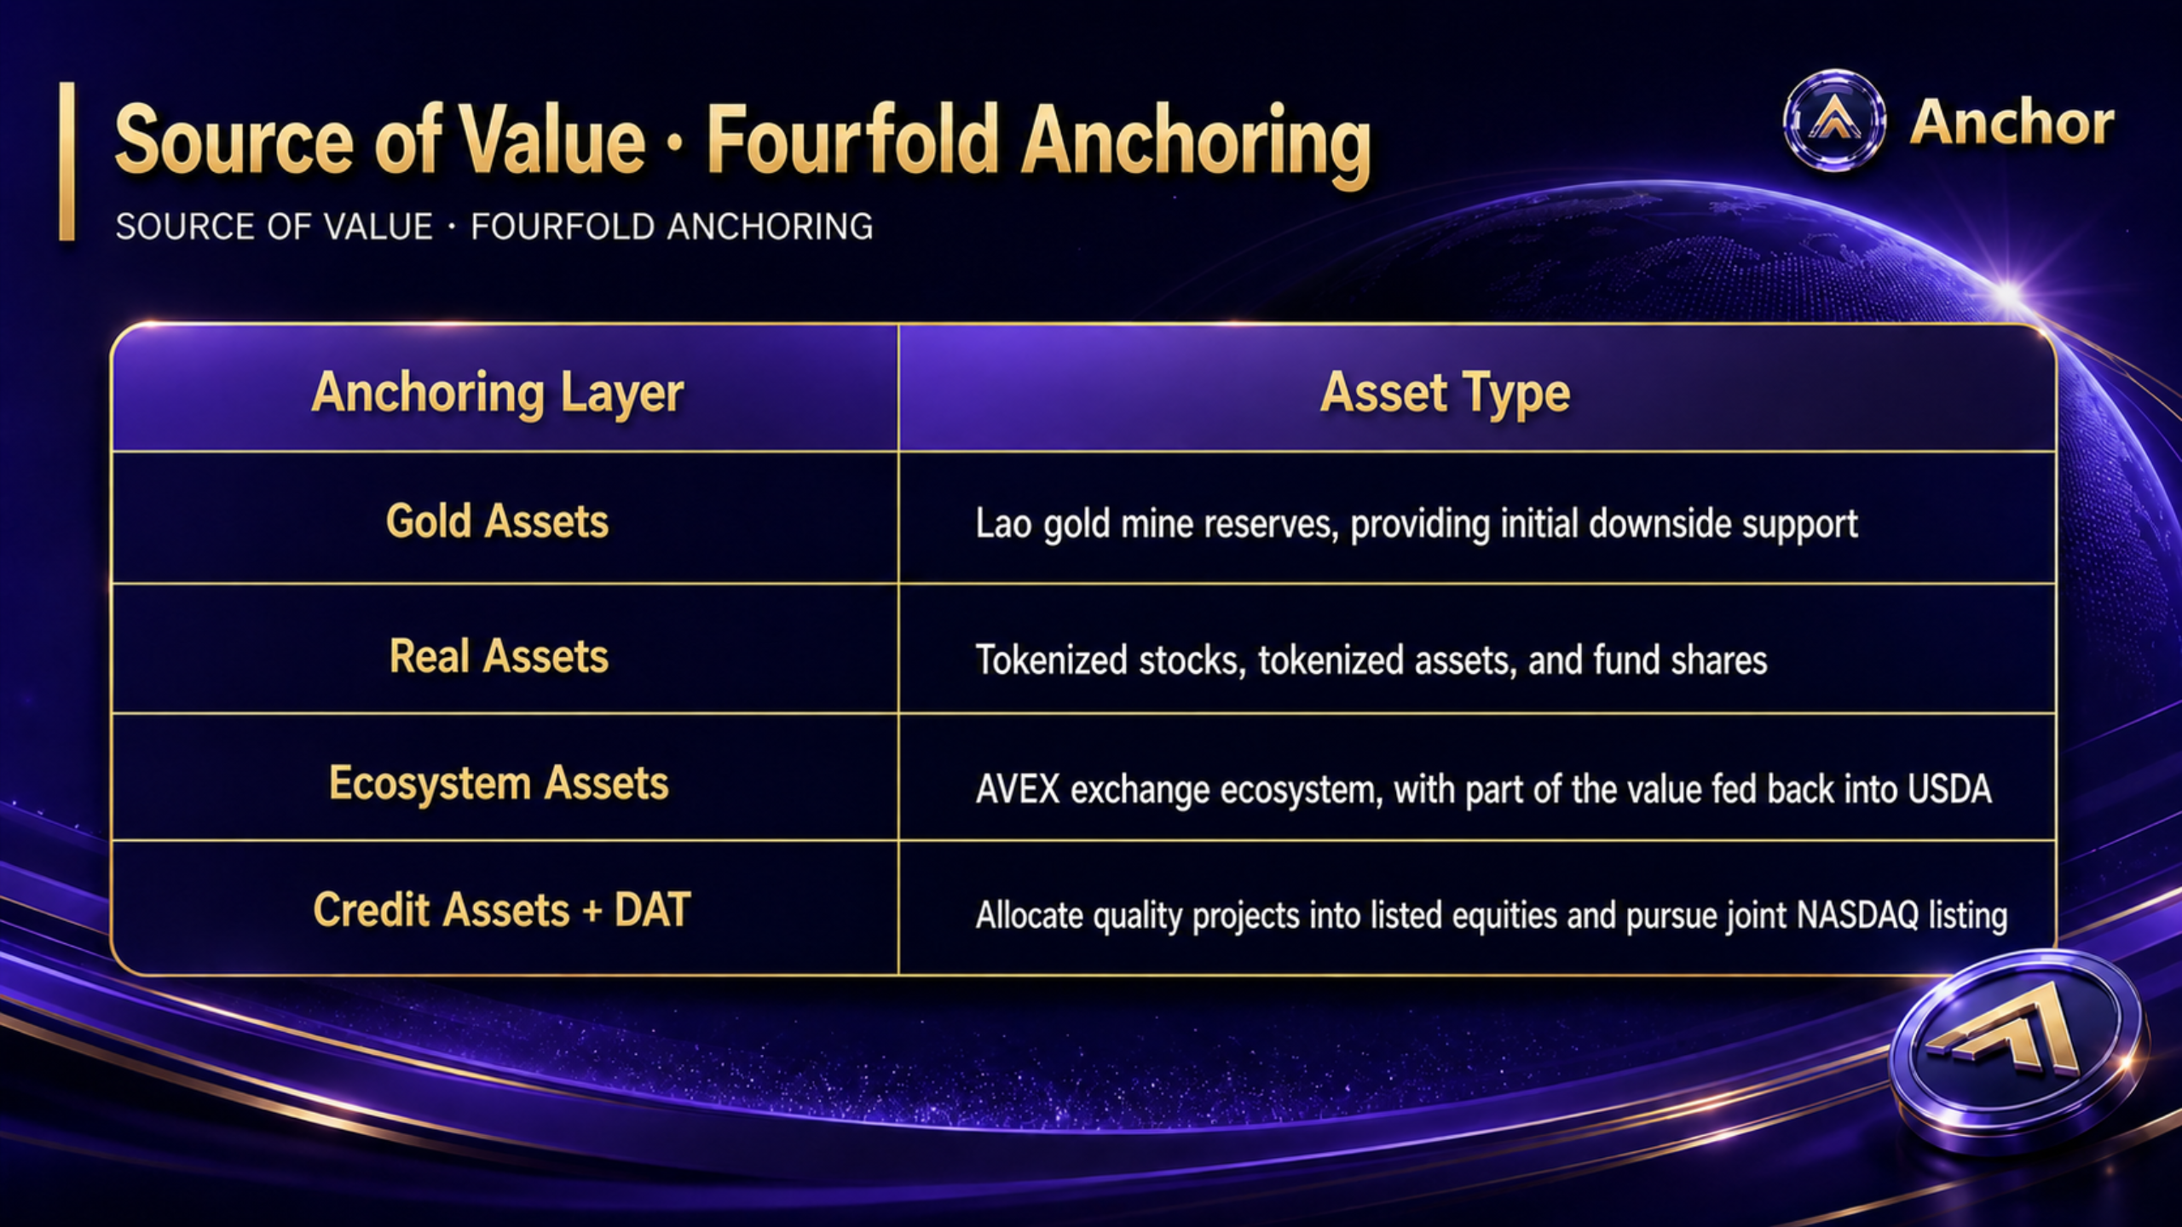
Notes:
[Sources]
- Korean source deck, slide 11.
- English text-localization applied to the approved complete-slide design.

Slide 12
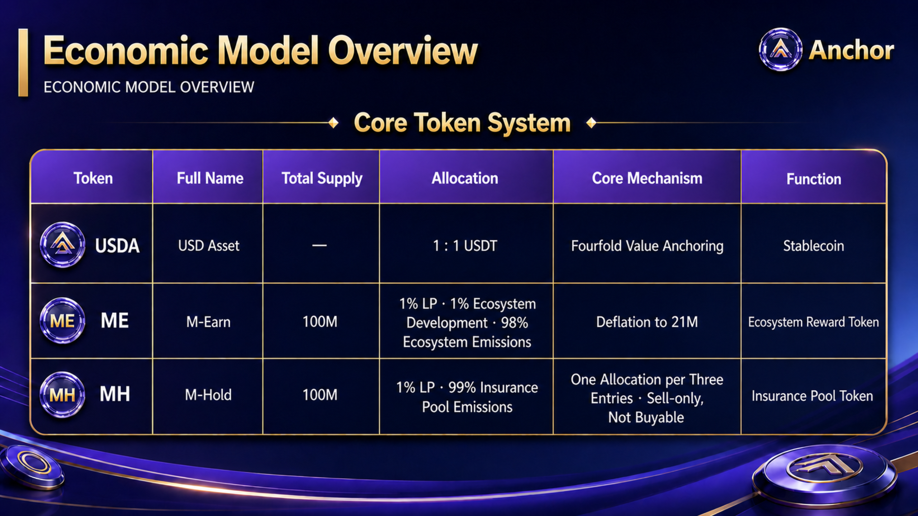
Notes:
[Sources]
- Korean source deck, slide 12.
- English text-localization applied to the approved complete-slide design.

Slide 13
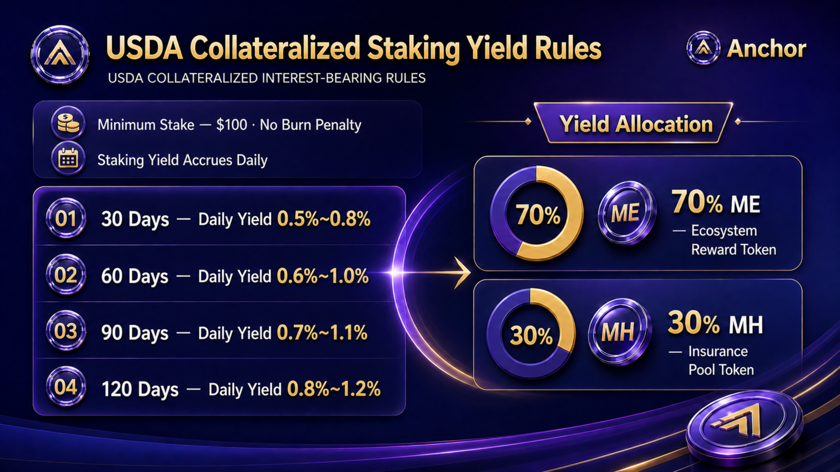
Notes:
[Sources]
- Korean source deck, slide 13.
- English text-localization applied to the approved complete-slide design.

Slide 14
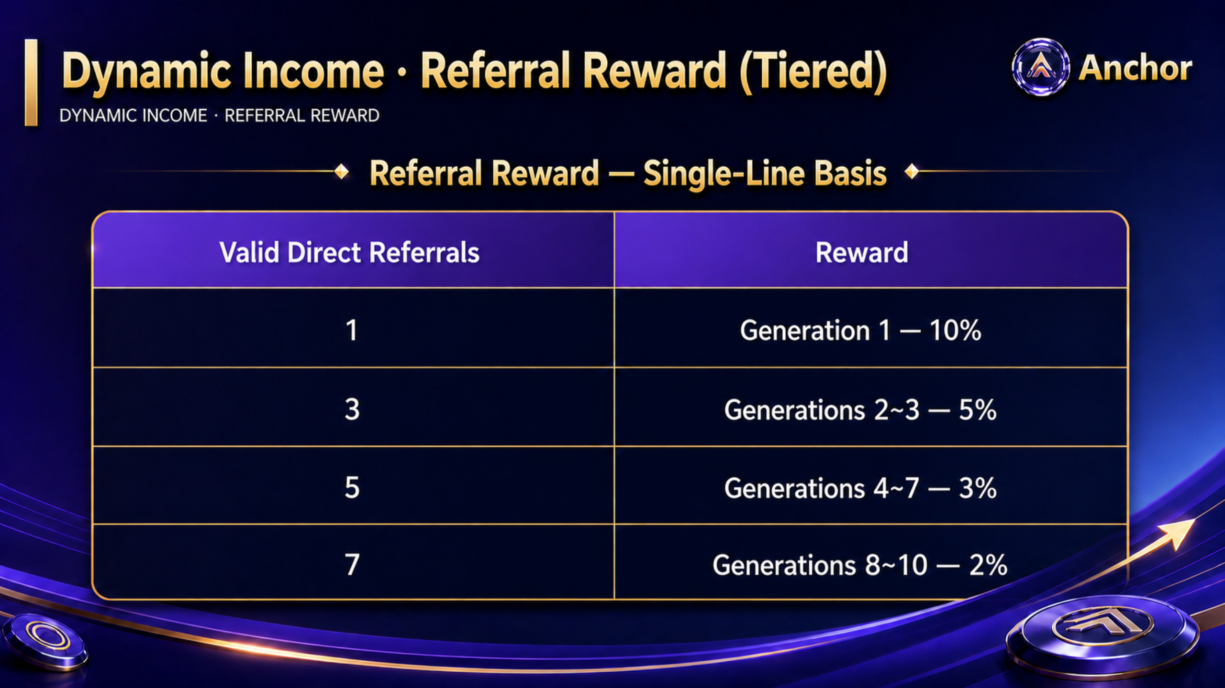
Notes:
[Sources]
- Korean source deck, slide 14.
- English text-localization applied to the approved complete-slide design.

Slide 15
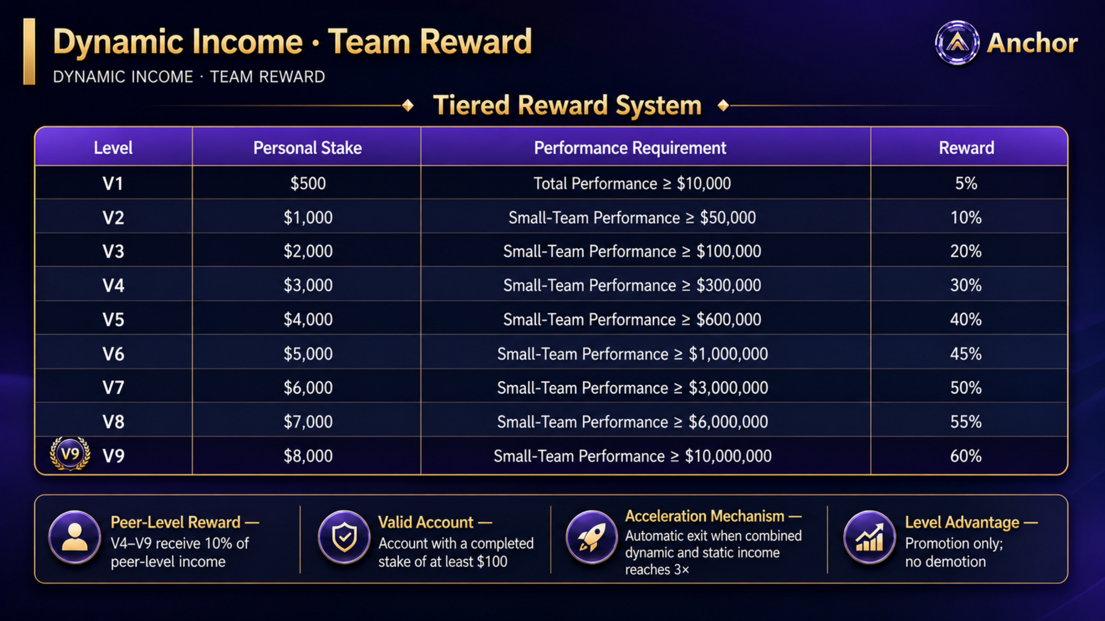
Notes:
[Sources]
- Korean source deck, slide 15.
- English text-localization applied to the approved complete-slide design.

Slide 16
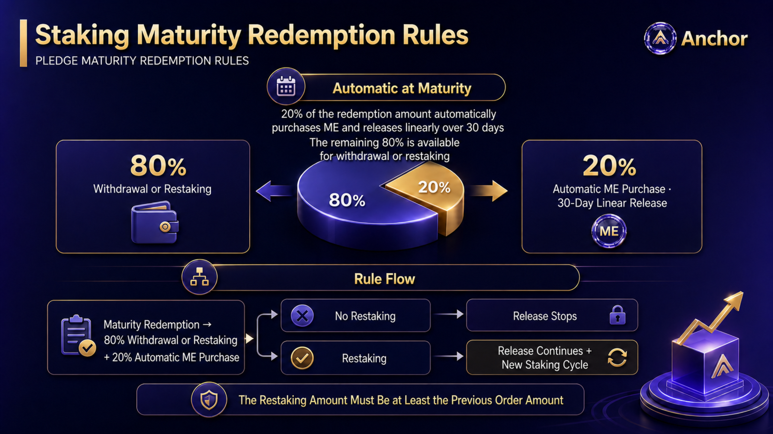
Notes:
[Sources]
- Korean source deck, slide 16.
- English text-localization applied to the approved complete-slide design.

Slide 17
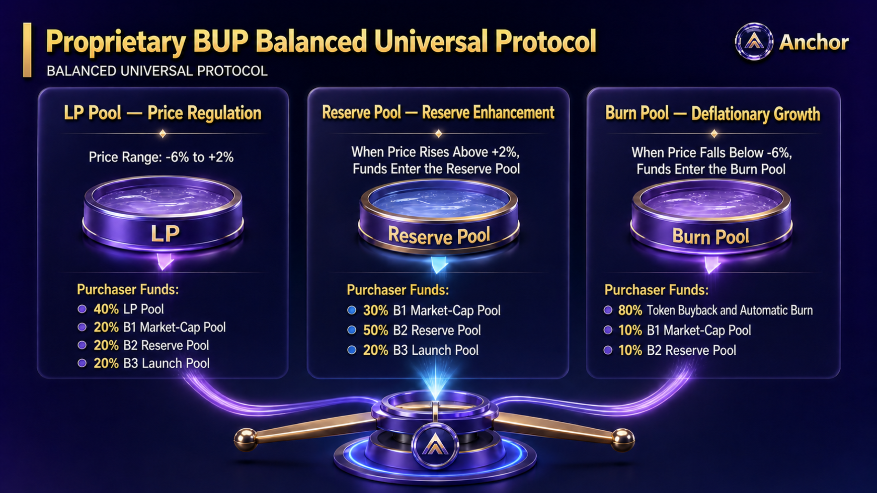
Notes:
[Sources]
- Korean source deck, slide 17.
- English text-localization applied to the approved complete-slide design.

Slide 18

Notes:
[Sources]
- Korean source deck, slide 18.
- English text-localization applied to the approved complete-slide design.

Slide 19
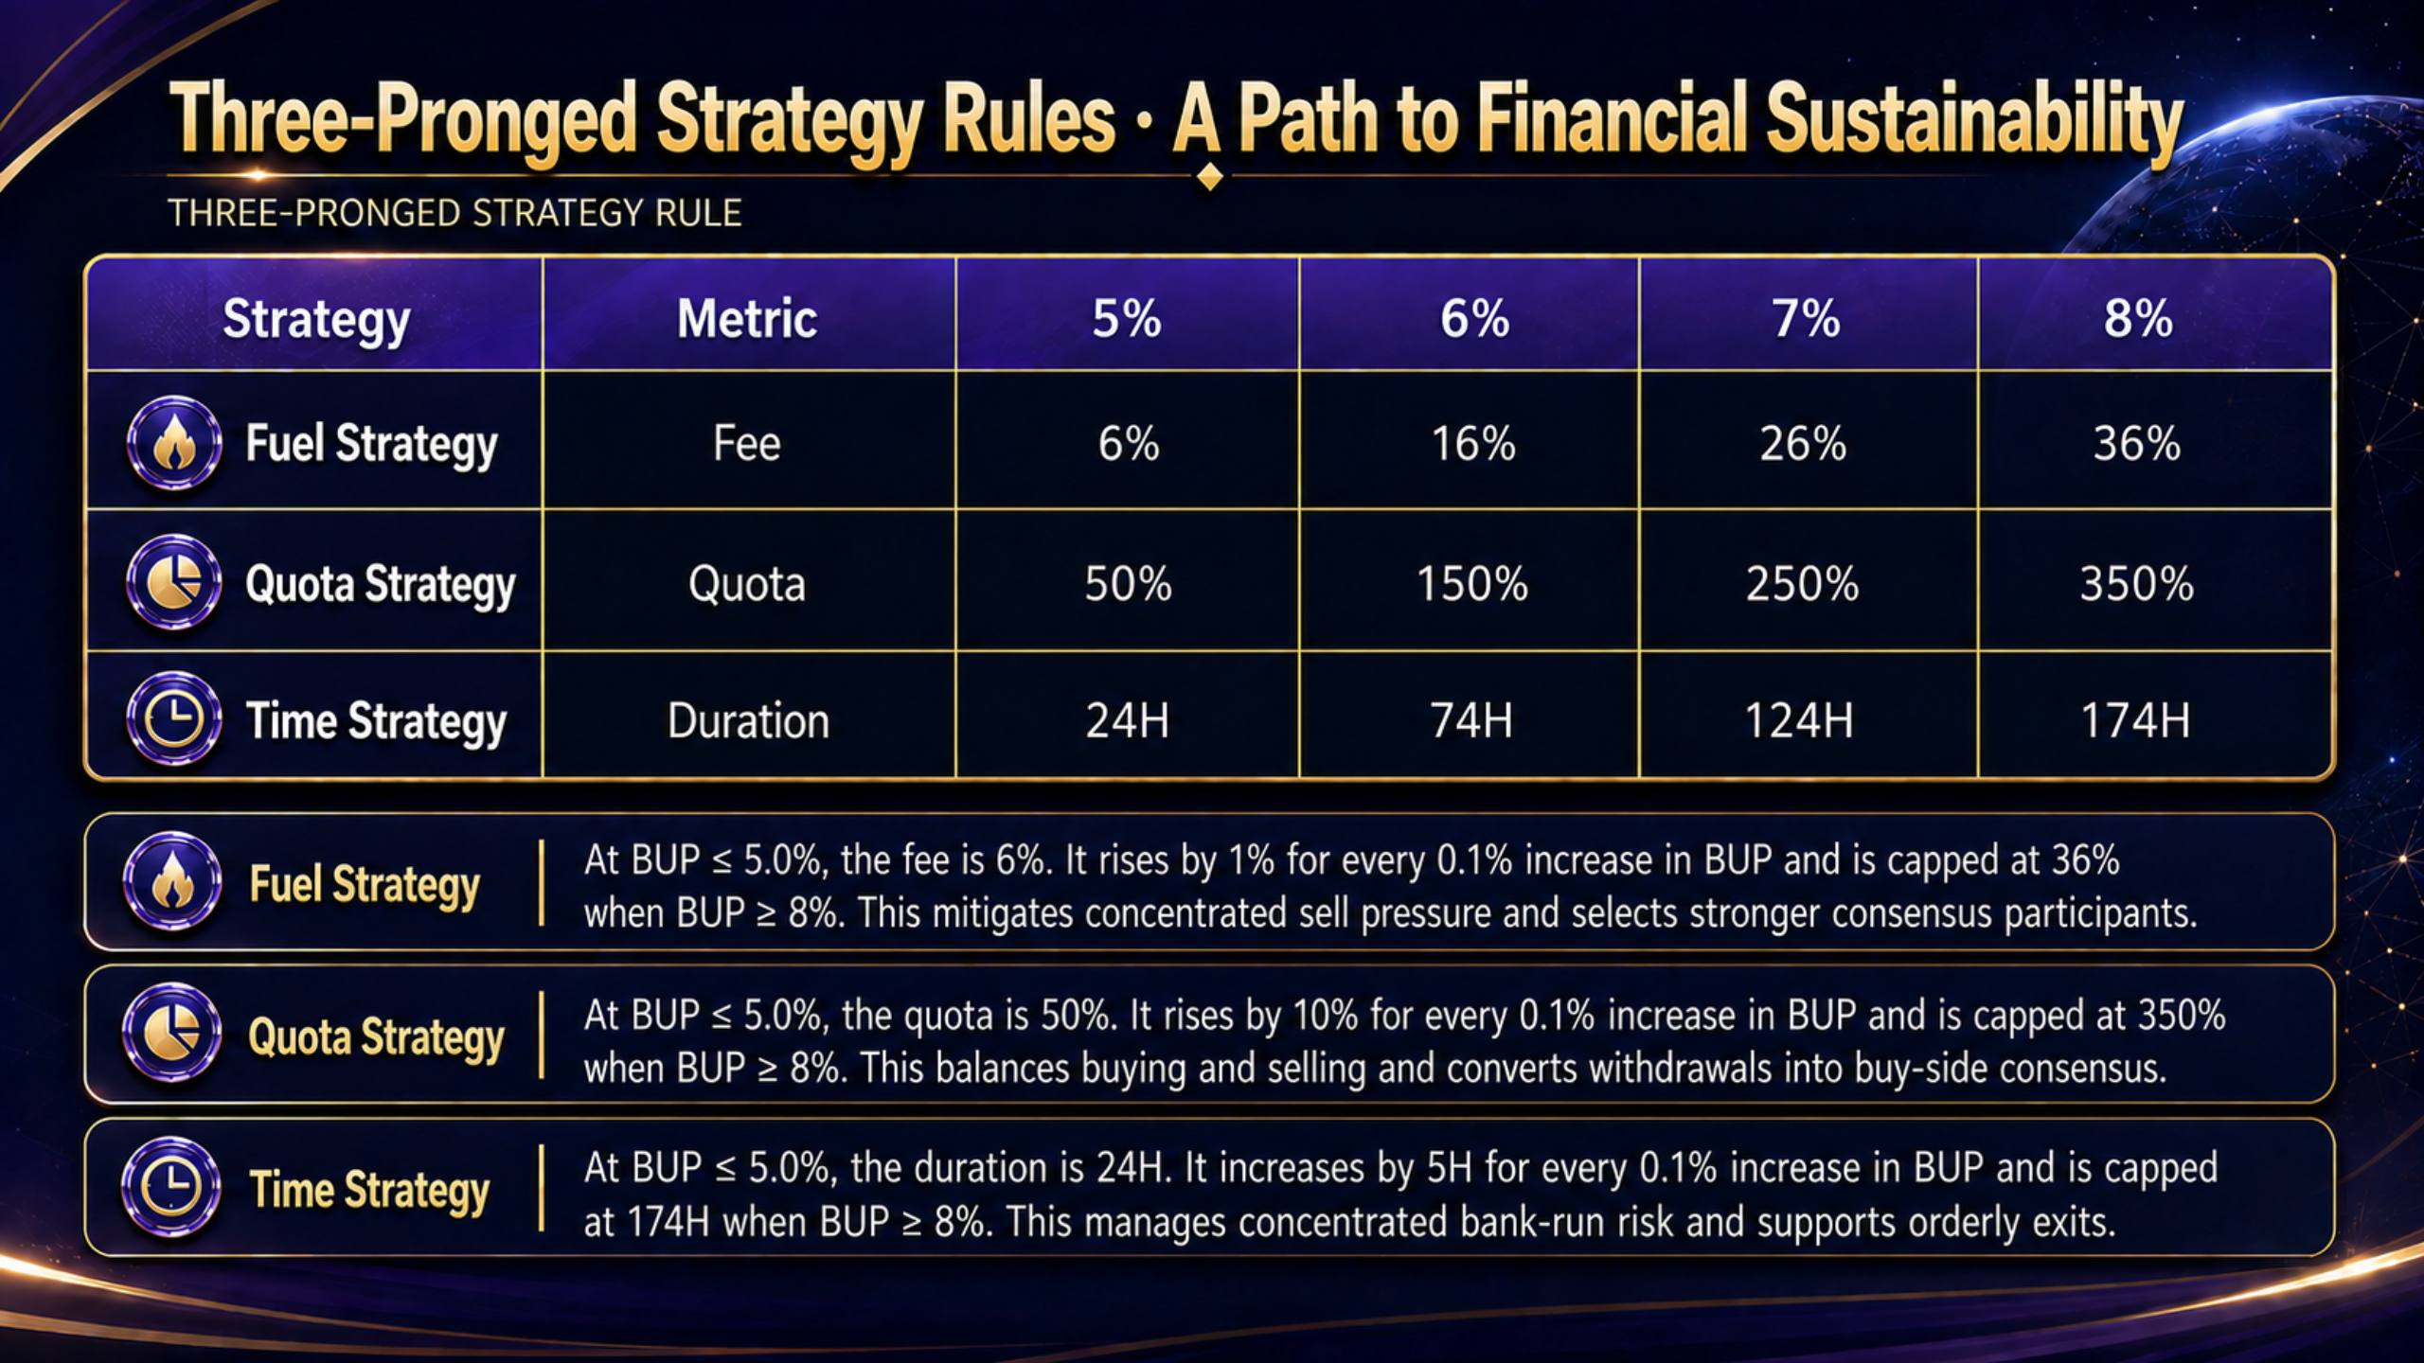
Notes:
[Sources]
- Korean source deck, slide 19.
- English text-localization applied to the approved complete-slide design.

Slide 20
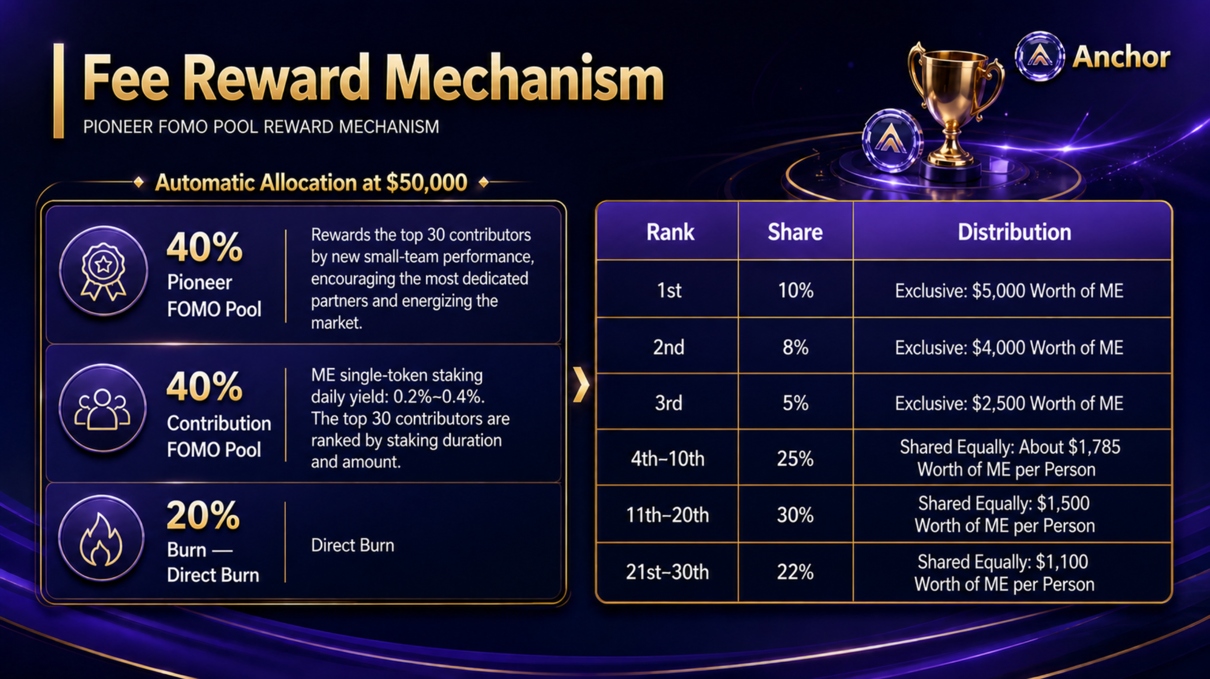
Notes:
[Sources]
- Korean source deck, slide 20.
- English text-localization applied to the approved complete-slide design.

Slide 21

Notes:
[Sources]
- Korean source deck, slide 21.
- English text-localization applied to the approved complete-slide design.

Slide 22
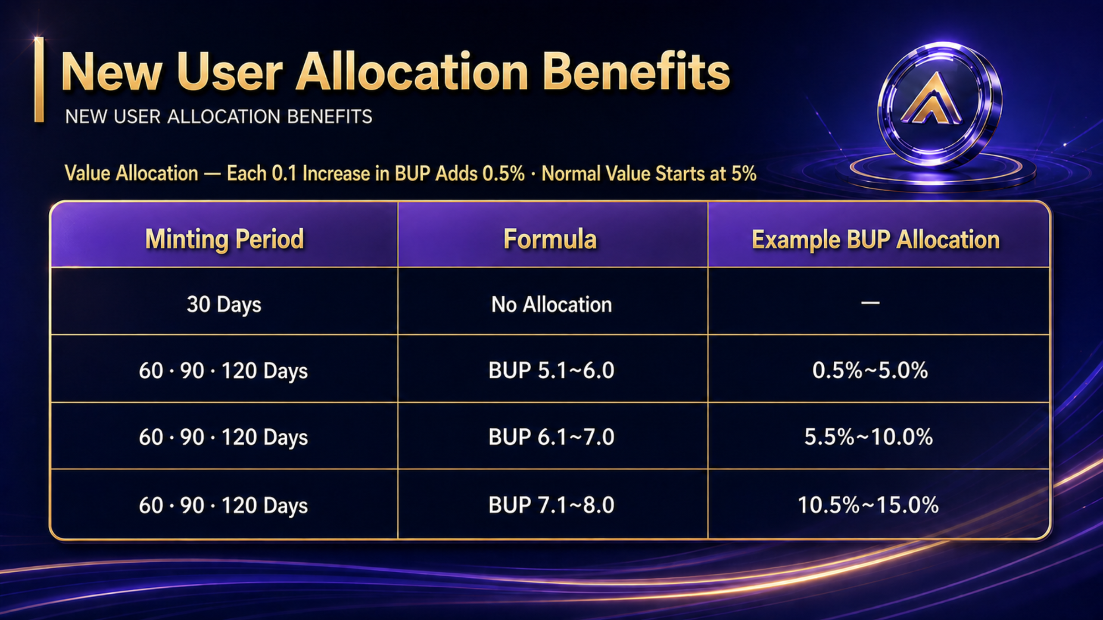
Notes:
[Sources]
- Korean source deck, slide 22.
- English text-localization applied to the approved complete-slide design.

Slide 23
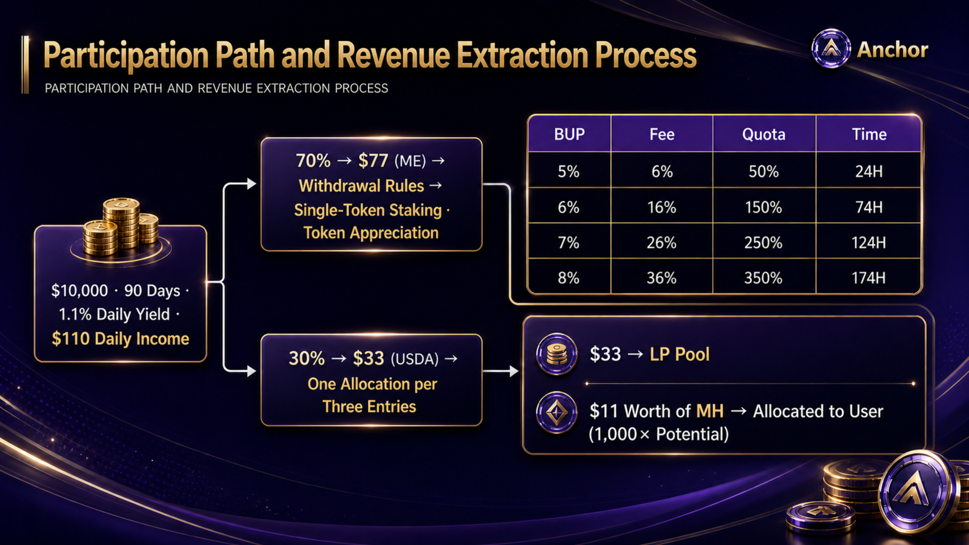
Notes:
[Sources]
- Korean source deck, slide 23.
- English text-localization applied to the approved complete-slide design.

Slide 24
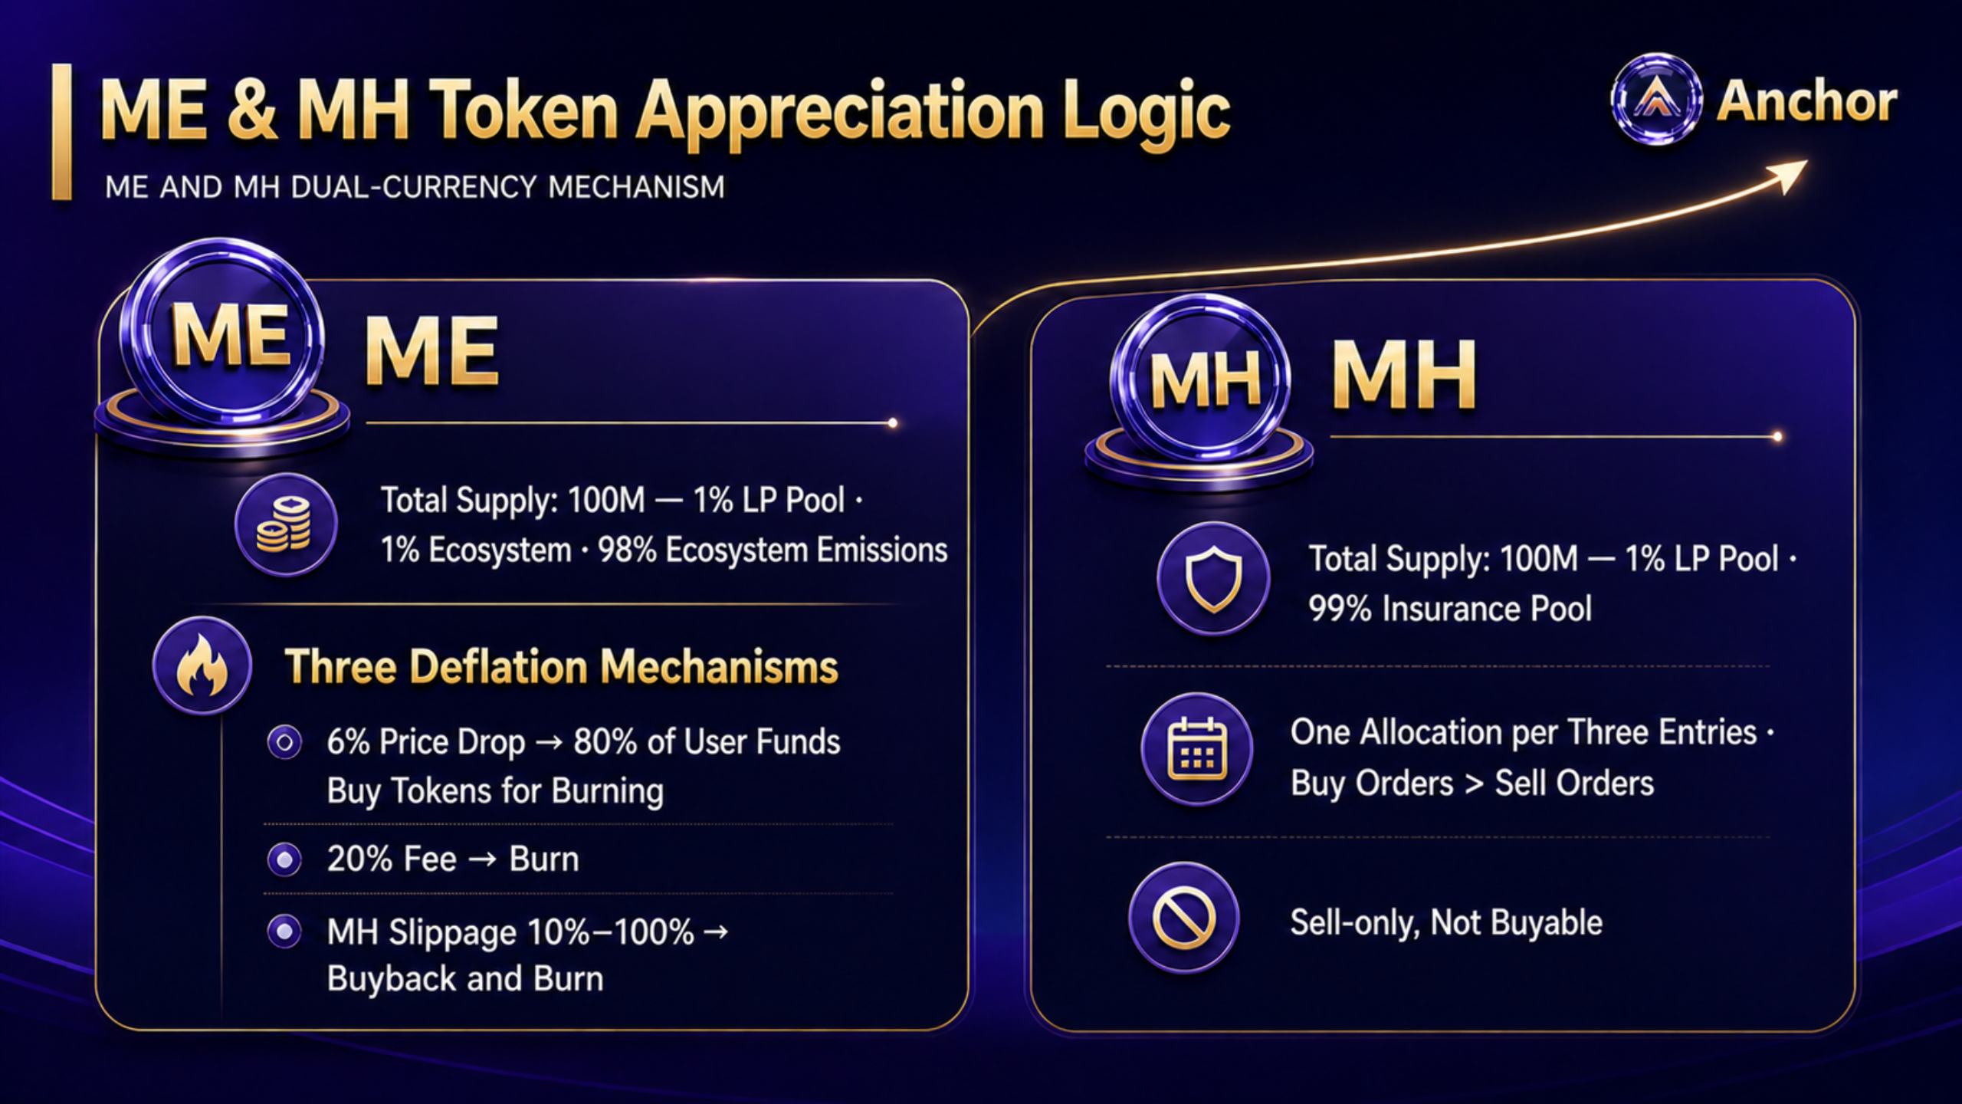
Notes:
[Sources]
- Korean source deck, slide 24.
- English text-localization applied to the approved complete-slide design.

Slide 25
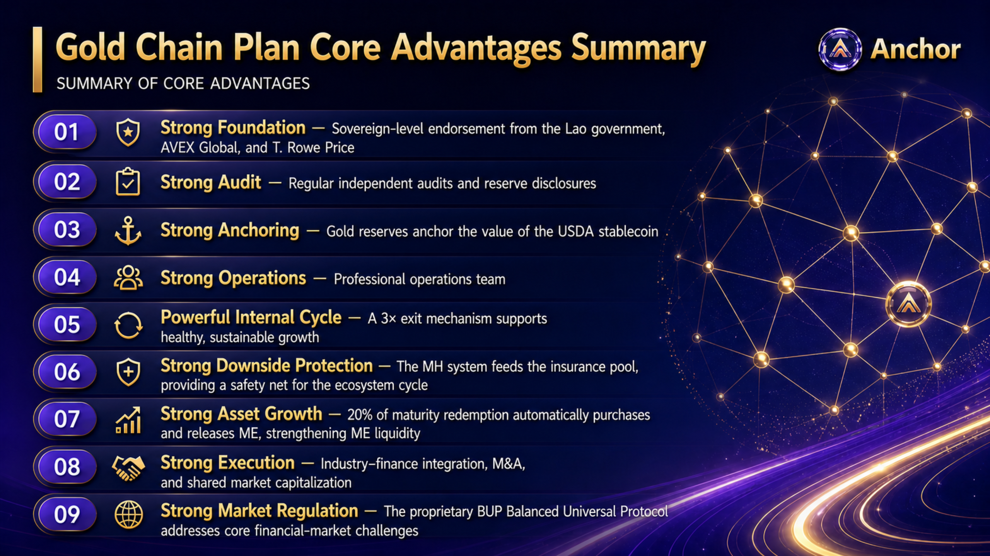
Notes:
[Sources]
- Korean source deck, slide 25.
- English text-localization applied to the approved complete-slide design.

Slide 26

Notes:
[Sources]
- Korean source deck, slide 26.
- English text-localization applied to the approved complete-slide design.

